Slide 1

TRAFFIC LIGHT CONTROLING USING IOT WITH COMPUTER VISION
PROJECT COORDINATOR:
Dr. Musheer Ahmed
UNDER THE SUPERVISON OF:
Prof Mohd AMJAD
DEPARTMENT OF COMPUTER ENGG,
FACULTY OF ENGG & TECHNOLOGY,
JAMIA MILLIA ISLAMIA,
NEW DELHI - 110025
SUBMITED BY:
SHADAN PARVEZ
21MCS017
M-Tech 3rd sem
9 september 2022

Slide 2

content
Problem definition and description
Proposed methodology
To-Do List
Component Use
Flow chart
Work Done
Remaining Work
Literature review
References

Slide 3
Problem : static traffic light management system
Traffic is the major issue in most of the country because of rapidly increasing of vehicles on road and our older structure is not that much intelligent to manage problem efficiently. As we know that technology is improving day by day, so we need to upgrade our systems.
In this project we trying to manage our traffic light according to the congestion on the road so that we can avoid traffic and reduce waiting time efficiently than a static traffic light controlling system.
So we trying to manage it dynamically by using IOT and computer vision

Slide 4
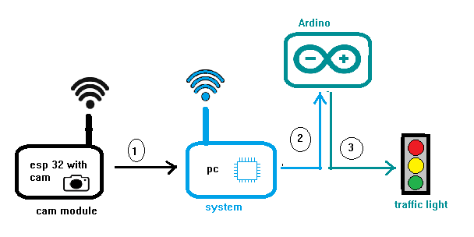
Proposed method
Algorithm :
Read data from cam ESP32
Send the data to Google Colab
Calculate the density of vehicles using computer vision
Set timer for each light
Calculate the sum of each timer and store in a variable x
Wait unit x sec over
Repeat from step 1
Figure:1 propose method
1. sending image data from ESP32 to PC.
2. sending variables data to arduino Uno.
3. arduino operate traffic lights

Slide 5

To-Do List
Capturing Data
Processing
do action

Slide 6
Component Used
Arduino uno
Wires
Esp32 cam
FTDI USB to TTL Serial Converter
LEDs
Resistance
Ethernet shield

Slide 7
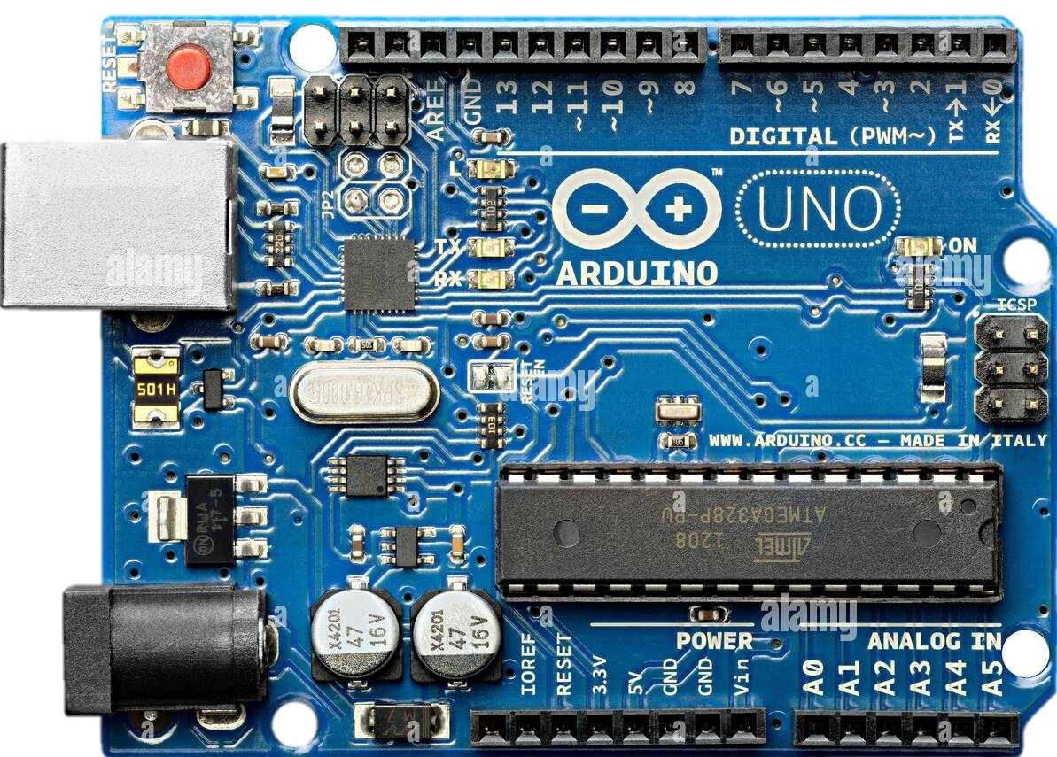
Arduino Uno :
Arduino is open source hardware board with many open source libraries to interface its on board microcontroller with many other external components like LED , motors, LCD, keypad, Bluetooth module, GSM module and many other things one want to interface with Arduino board. Arduino is basically make from a microcontroller but Arduino have all external socket to connect with other devices and it also have built in programmer which is used to program Arduino from computer. So Arduino is a complete board which include all things to connect with external peripheral and easy to program through computer. There are many Arduino boards are available. But Arduino UNO R3 which is very
Figure : Arduino uno

Slide 8
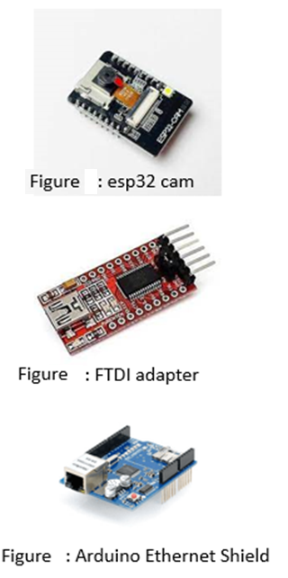
ESP32-CAM:
The ESP32-CAM is a small size, low power consumption camera module based on ESP32. It comes with an OV2640 camera and provides onboard TF card slot. The ESP32-CAM can be widely used in intelligent IoT applications such as wireless video monitoring, WiFi image upload, QR identification, and so on
FTDI adapter
It is used for connecting esp32 cam to PC
Arduino Ethernet Shield
The Arduino Ethernet Shield allows an Arduino board to connect to the internet using the Ethernet library
2
3
4

Slide 9
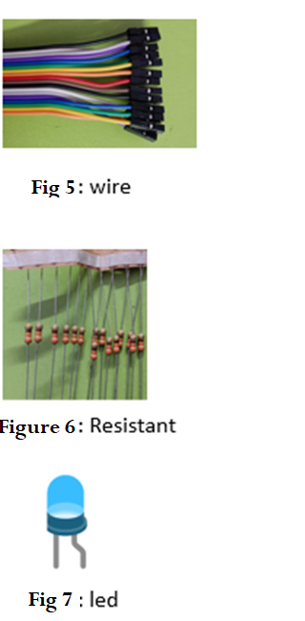
Wires :
A wire is a single usually cylindrical, flexible strand or rod of metal. Wires are used to bear mechanical loads or electricity and telecommunications signals.
Resistant :
Resistance is the opposition that a substance offers to the flow of electric current. It is represented by the uppercase letter R. The standard unit of resistance is the ohm, sometimes written out as a word, and sometimes symbolized by the uppercase Greek letter omega:
Led :
A light-emitting diode (LED) is a semiconductor light source that emits light when current flows through it

Slide 10
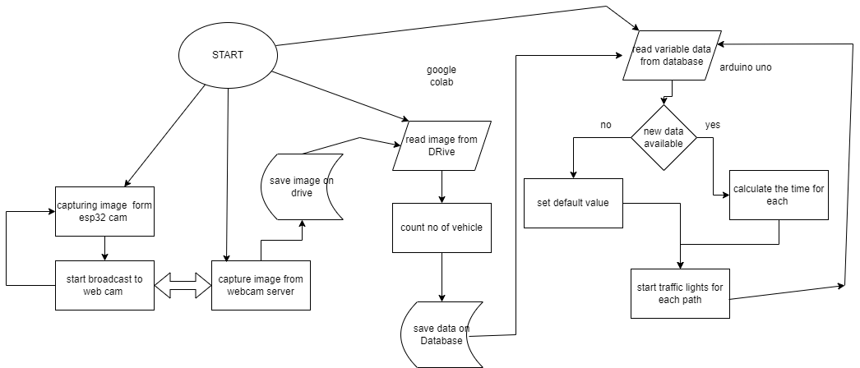
Flow chart
Fig:8 Flow chart for proposed method

Slide 11

Work done

Slide 12
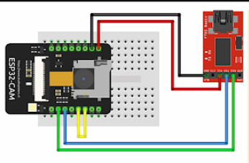
Capturing Data
Reading Data from ESP32 and forwarding data to Google Drive (Free cloud storage )
Steps:
Webcam initialization
Connecting to internet
webcam broadcast start on URL
We use Google Apps Script for capturing image from webcam and Send data to Google Drive
we use Arduino IDE for programming (language C++ )
we need FTDI adapter to connect it to your computer and upload code
Figure 9a: connecting Esp32-cam and FTDI adapter.
Green : GP01 ←→ RX
Blue : GP03 ←→TX
Red: power
Black :ground

Slide 13
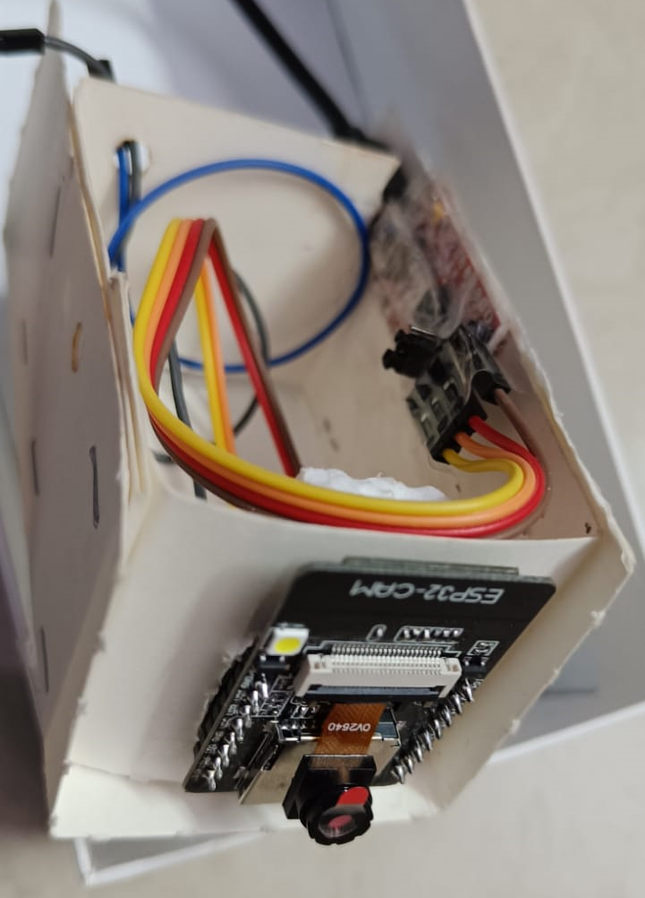
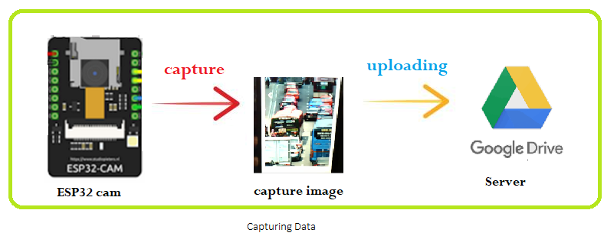
Capturing Image
Diagram 1:
Here I taken an image from esp32 cam
Then send that image to drive.
Fig 9b: Device image

Slide 14
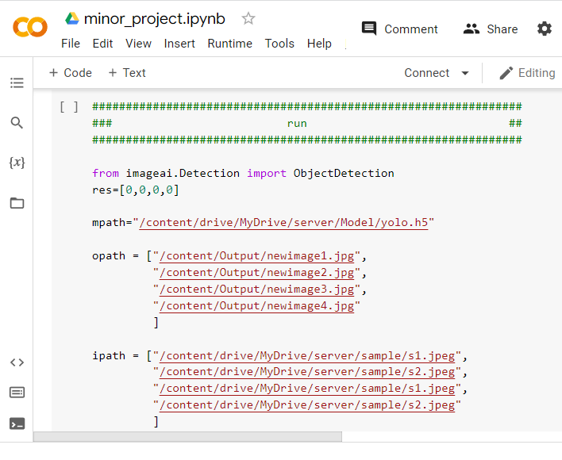
Processing image
Setup required libraries, data and environment.
Here we using google colab notebook with GPU so we achieved fast computation
In this we used YOLO v5 model in deep learning for vehicle detection
After counting no of vehicle we saved the data in an array
The result is updated in Ubidots.
Language used python
Fig 10 :CNN program in colab

Slide 15
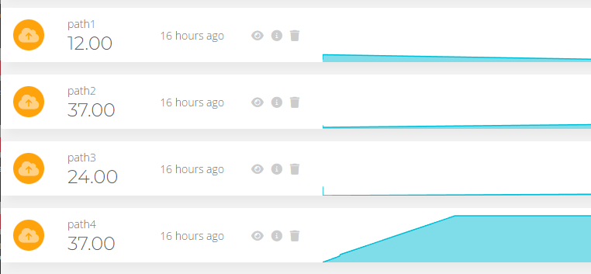
Storing Data for communication
On Ubidots we created an device name as traffic
In traffic we have 4 variable {path1,path2,path3,path4} for save data
Detected no of object in each path is saved in database provides by Ubidots.
Some sample data is send for checked purpose
Challenges:
We have only 5 variables
Figure 11 : successfully variables are stored in Ubidots
after processing image

Slide 16
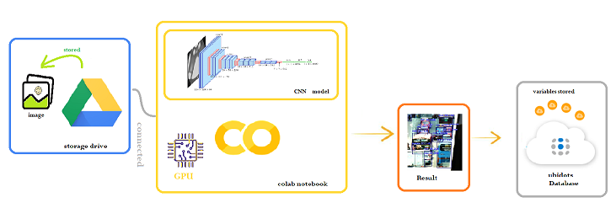
Processing Image
Diagram 2: Image processing
Here , we already have an image on our google drive storage which was stored on previous step. So
here we using CNN Model to identify the vehicle and count it then we forward that data to
Ubidots for storing variables data.

Slide 17
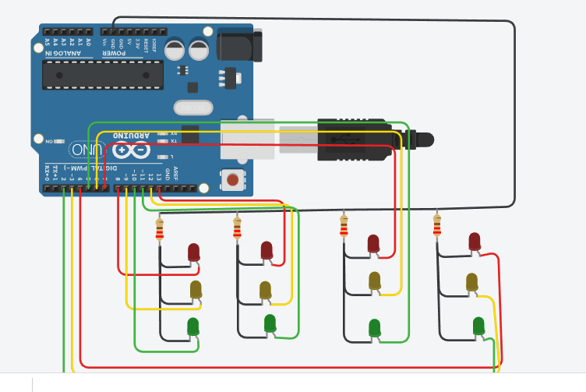
Arduino uno program
We checked our code with sample data on Arduino uno board by using tinker cad
Both static and dynamic method checked
Challenges:
Less no of digital pins available.
Less storage space for programming.
Fig 12:Arduino uno light circuit diagram

Slide 18

Remaining work
Communication between Arduino and Ubidots.
Build light circuit

Slide 19
Literature review
S.no | Author | Year | Title | About | Journal/conference | publisher
1 | Younes, M. B., & Boukerche, A. | (2017, March 6). | An efficient dynamic traffic light scheduling algorithm considering emergency vehicles for intelligent transportation systems | From this paper we get better understanding of our problem We have 8 pairs of traffic and we have to mange them | Wireless Netw 24, 2451–2463 | SpringerLink
2 | Khalid Al-Khateeb; Jaiz A. Y. Johari | (2008, May 15) | Intelligent dynamic traffic light sequence using RFID | The proposed RFID traffic control avoids problems that usually arise with standard traffic control systems, especially those related to image processing and beam interruption techniques. This RFID technique deals with a multi-vehicle, multilane, multi road junction area. It provides an efficient time management scheme, in which a dynamic time schedule is worked out in real time for the passage of each traffic column. | 2008 International Conference on Computer and Communication Engineering pp. 1367-1372 | IEEE

Slide 20
References
Zhengxing , X. (2022, July 26). Indigenous design of a Traffic Light Control system responsive to the local traffic dynamics and priority vehicles - ScienceDirect. Indigenous Design of a Traffic Light Control System Responsive to the Local Traffic Dynamics and Priority Vehicles - ScienceDirect; www.sciencedirect.com. https://www.sciencedirect.com/science/article/abs/pii/S0360835222005198
Wen, W. (2021, April 1). Dynamical systems approach for queue and delay estimation at signalized intersections under mixed traffic conditions. Dynamical Systems Approach for Queue and Delay Estimation at Signalized Intersections under Mixed Traffic Conditions - ScienceDirect; www.sciencedirect.com. https://www.sciencedirect.com/org/science/article/abs/pii/S1942786722004544
Wen, W. (2007, April 4). A dynamic and automatic traffic light control expert system for solving the road congestion problem - ScienceDirect. A Dynamic and Automatic Traffic Light Control Expert System for Solving the Road Congestion Problem - ScienceDirect; www.sciencedirect.com. https://www.sciencedirect.com/science/article/abs/pii/S0957417407001303
Zhang, Y., & Su, R. (2021, January 4). An optimization model and traffic light control scheme for heterogeneous traffic systems. An Optimization Model and Traffic Light Control Scheme for Heterogeneous Traffic Systems - ScienceDirect; www.sciencedirect.com. https://www.sciencedirect.com/science/article/abs/pii/S0968090X20308111
Abdulrahman Mansour Halawani. (2022, June ). Intelligent Traffic Lightshttps://www.researchgate.net/publication/361025204_Intelligent_Traffic_Lights
Priyankar Roychowdhury, University of Notre Dame,Sarjo Das (2014 Noverber ) Automatic Road Traffic Management System in a City Priyankar Roychowdhury, Sarjo Das* Department of Electronics and Communication Engineering, Techno India, Kolkata, India
Younes, M. B., & Boukerche, A. (2017, March 6). An efficient dynamic traffic light scheduling algorithm considering emergency vehicles for intelligent transportation systems - Wireless Networks. SpringerLink. https://link.springer.com/article/10.1007/s11276-017-1482-5
Noman, M., & Tawfik, A. (2019, December). Object Detection Techniques: Overview and Performance Comparison. Object Detection Techniques: Overview and Performance Comparison. https://ieeexplore.ieee.org/document/9001879
Yanfeng Geng & Christos G. Cassandras. (2013, December). Quasi-dynamic traffic light control for a single intersection. Quasi-Dynamic Traffic Light Control for a Single Intersection. https://ieeexplore.ieee.org/abstract/document/6759993

Slide 21
Thank you

